Slide 1
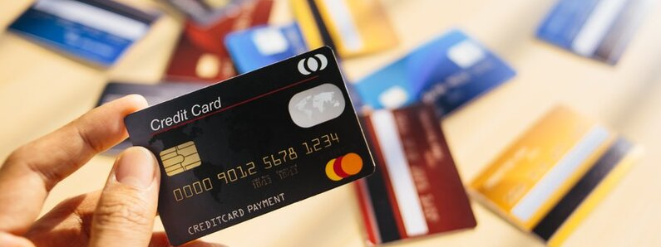
Credit Card Approval Prediction
Group 3:
Adrian Vasques
Johnny Zhang

Slide 2
Problem Statement
Credit score cards are a common risk control method in the financial industry
It uses personal information and data submitted by credit card applicants to predict the probability of future defaults and credit card borrowings.
Build a machine learning model to predict if an applicant is 'good' or 'bad' client

Slide 3
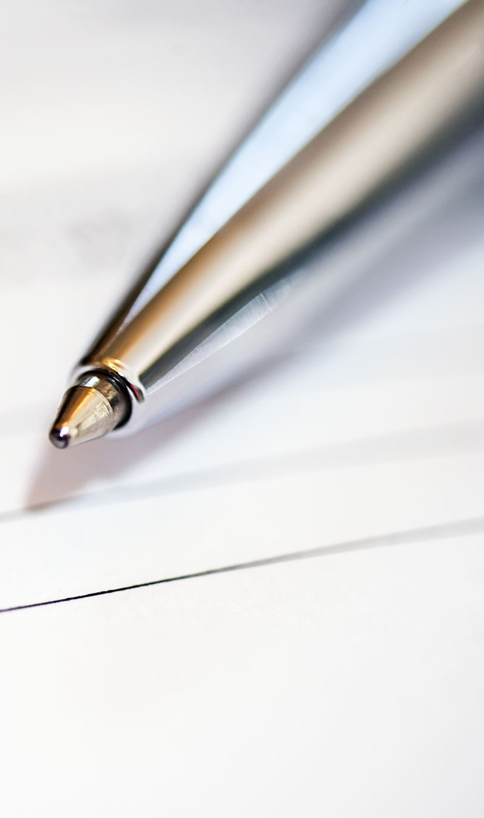
Research Questions
How can we predict if customers will default on their loan/credit?
How to predict if a customer will be profitable based on?
How will we determine what classifies as a bad customer based on credit history?
What variables are most significant in predicting whether a consumer will default?
What variables will predict if a customer is past due for more than 180 days and will eventually be charged off?

Slide 4
Data Source
Kaggle
application_record.csv contains appliers personal information
credit_record.csv records users' behaviors of credit card.
Connected by Customer ID

Slide 5



Definition of 'good' or 'bad’ Customer
Percent_Late: create a variable a binary attribute that helps us identify what customers were most profitable by means of late free.
Method We aggregated the total credit history in months, and divided it by the total amount of months the record was late for 1-2 months
Criteria: record that had lat no more than 40 percent of the time but were never late for for more than 3 months in a row

Slide 6
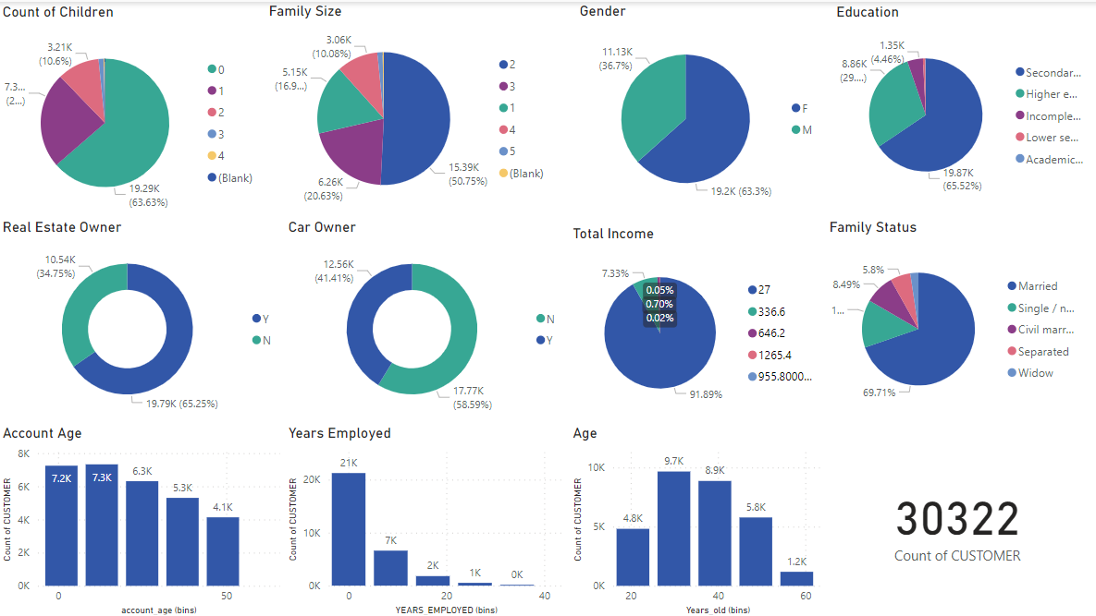
Descriptive Analysis
Created by PowerBi

Slide 7
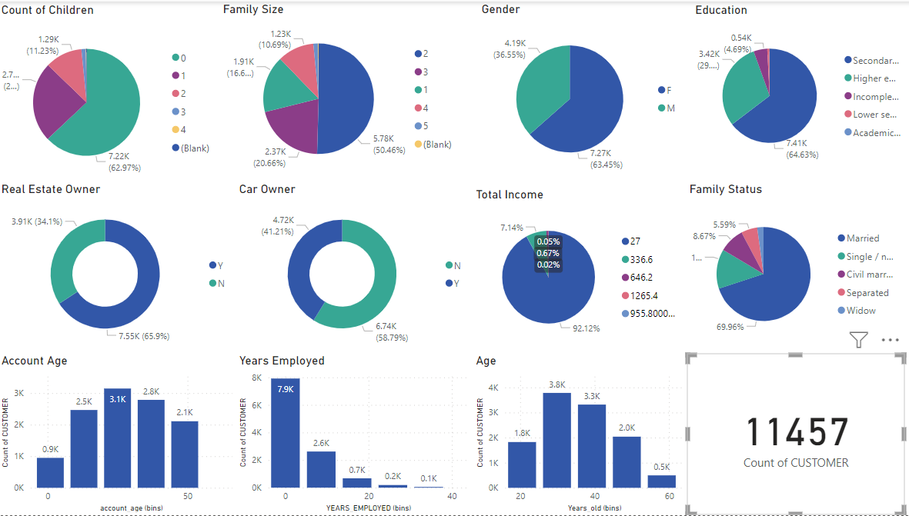
Good Customer
Count of Children : 0
Family Size : 2 - 3
Gender : Female
Education : Secondary
Property Owner : Yes
Car Owner : No
Total Income: under 27k
Family Status: Married
Years Employed: 0-5 years

Slide 8
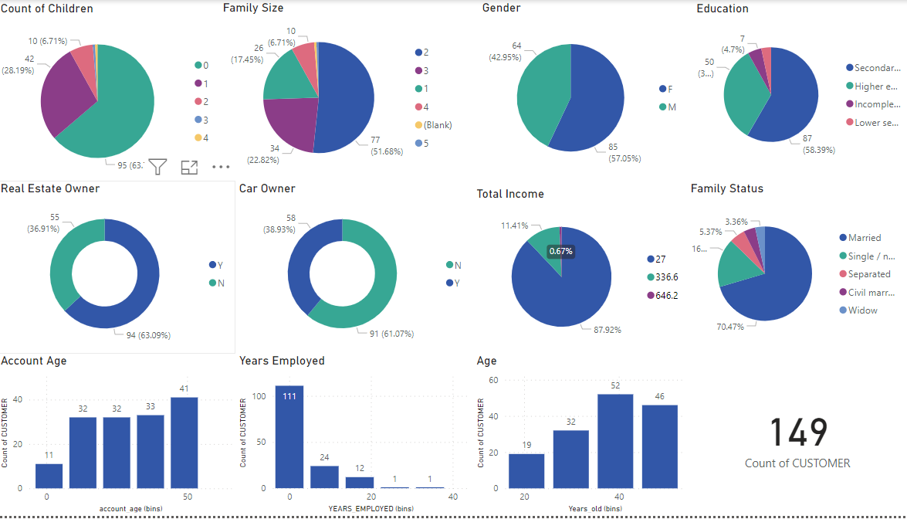
Bad Customer
Count of Children : 0
Family Size : 2 - 3
Gender : Female
Education : Secondary
Property Owner : Yes
Car Owner : No
Total Income: under 27k
Family Status: Married
Years Employed: 0-5 years

Slide 9
Data Cleaning and Preparation
Identify missing data: No Null Value or Missing Value
Identifying any outliers: Income
Removing duplicates: “Month_balance” and “payment status”
Create dummy variables: CODE_GENDER","FLAG_OWN_CAR","FLAG_OWN_REALTY","CNT_CHILDREN","NAME_INCOME_TYPE","NAME_EDUCATION_TYPE", ”NAME_FAMILY_STATUS", "NAME_HOUSING_TYPE", "CNT_FAM_MEMBERS"
Removing Columns: Cell phone
Merge categorical variable with many levels: Amt Children, Amt_family_member

Slide 10
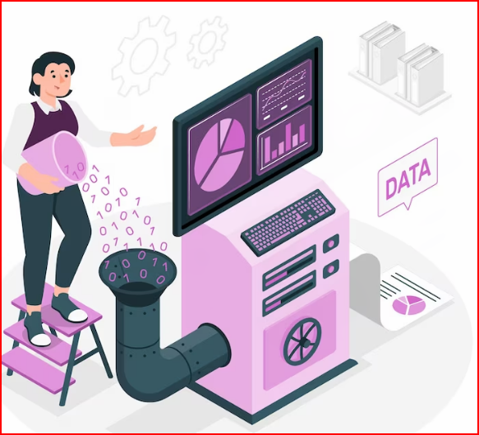
Feature Engineering
Create a binary feature which identifies if a customer is delinquent based on industry standard of 6 month overdue

Slide 11
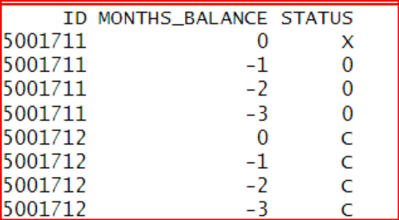
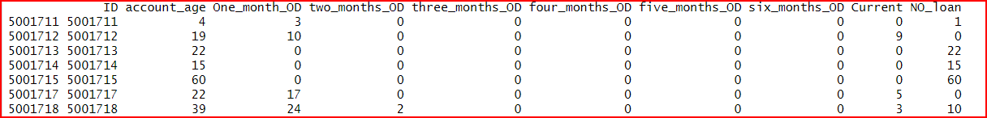
Before Feature Engineering:
After Feature Engineering

Slide 12
Unbalanced Data Set
Majority Class: 36277 = 99.5%
Minority class: 180 = .5%
Undersample: 180 majority and minority
Oversample: 36277 majority and minority

Slide 13
Engineered Feature 2
Percent_Late: Created a binary variable that helps us identify what customers were profitable by means of late free generation.
Feature Engineering: We aggregated the total credit history in months, and divided it by the total amount of months the record was late for 1-3 months
Criteria: record that had lat no more than 40 percent of the time but were never late for for more than 3 months in a row

Slide 14
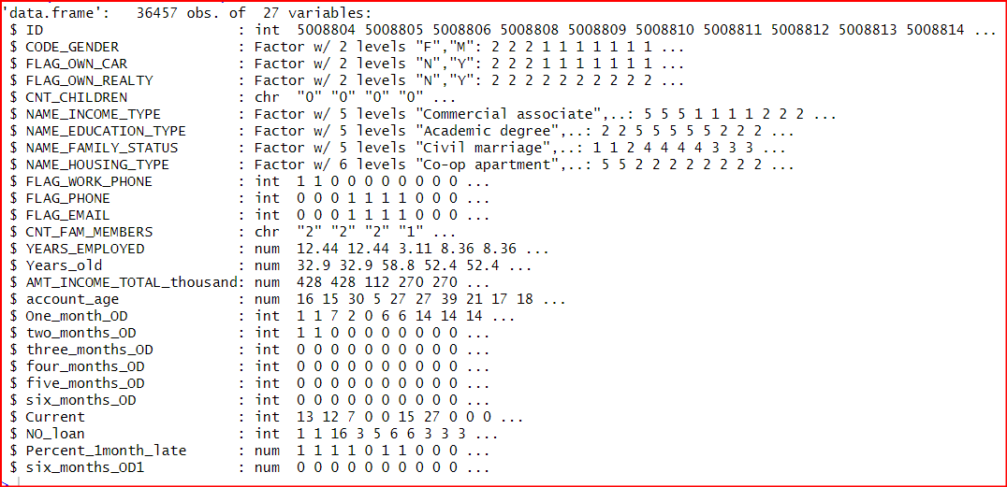
Merge Demographic data and New Data with feature engineering

Slide 15
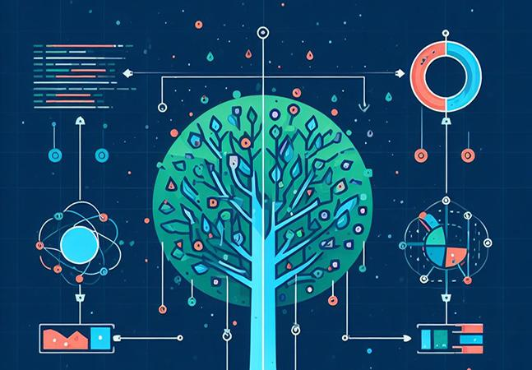
How can we predict if customers will default on their loan/credit?
Perform Feature engineering to create dependent variable to be used classification analysis.
Create a Balanced Data set to be used in classification analysis.
Build various supervised learning algoriths to predict if a customer will delinquint.
Evaluate the model ,and choose the best model and gain insight on how it can help management

Slide 16
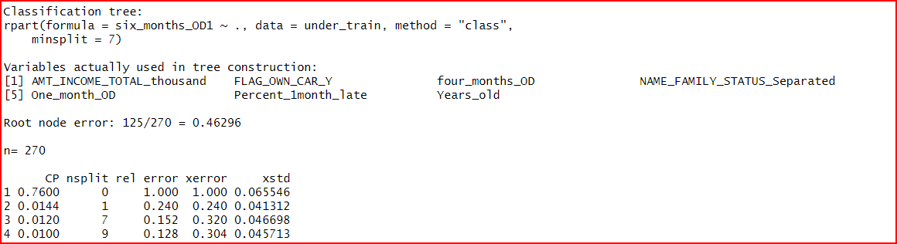
Cost Parameter

Slide 17
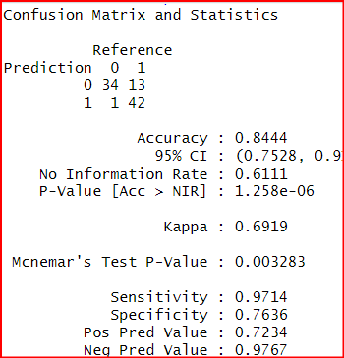
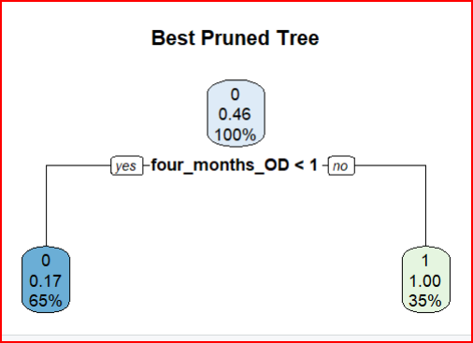
Best pruned tree

Slide 18
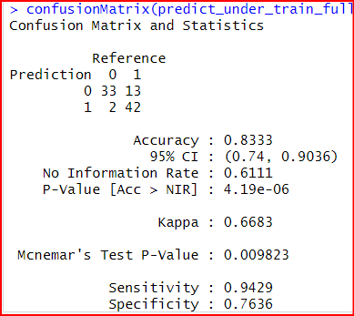
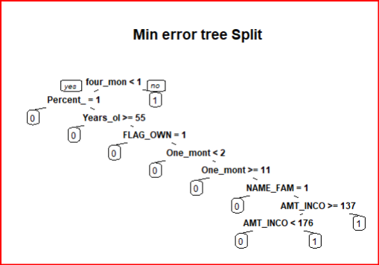
Full Tree
Decision Decision

Slide 19
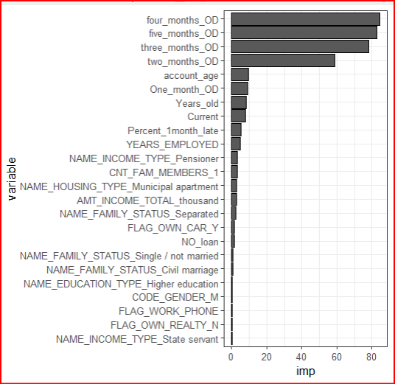
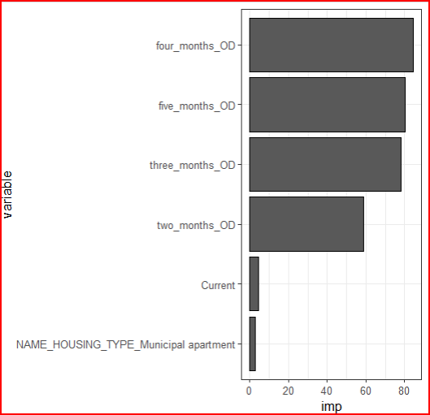
Best Pruned Min error

Slide 20
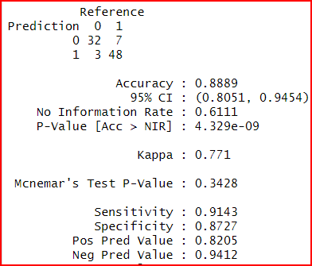
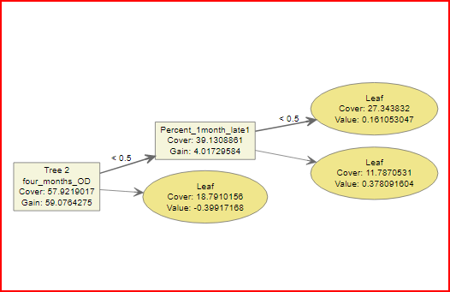
XG Boost

Slide 21
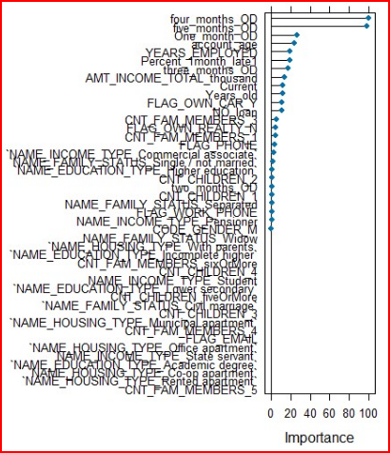
XG Boost to predict If a customer will be delinquint
Five Most Important Variables
Four Month Overdue
Five Months Overdue
One Month Overdue
Percent Late
Account age

Slide 22
Best method to predict is a customer will default on there loan
Methods used: After careful analysis we learned that no model deemed fit to predict whether the customer will default on there loan.
Assigning them them all to the majority class will produce better accuracy than any of the models we built.
Mcnemar test P -Value .11 Not significant in predicting better than the majoriety class

Slide 23
Late Fee Prediction
How can We predict if a customer will be profitable based on our data.
Perform Feature engineering to create dependent variable to be used classification analysis.
Build various Decision Trees and logistics regression model to predict if a customer will be late.
Evaluate the model ,and choose the best model and gain insight on how it can help management

Slide 24
Late Fee prediction
Late Fee Models | Accuracy | Sensitivity | specificity
Cart full | .9182 | .9311 | .8969
Xgboost | .8889 | .9730 | .5
Best pruned | .9182 | .9311 | .8969
Min error | .8575 | .8567 | .8588
Log forward | .6417 | .9203 | .1825
Backward | 0.6421 | 0.1836 | 0.9203

Slide 25
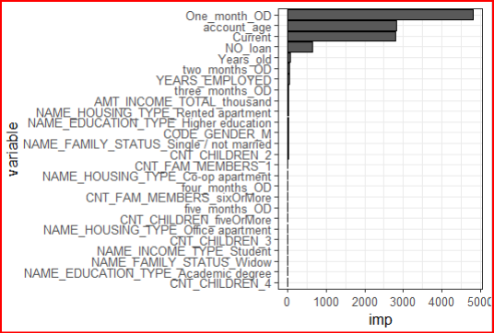
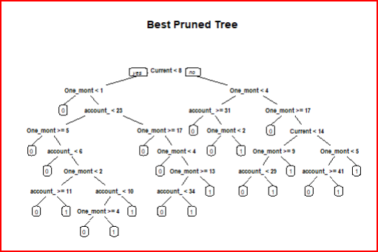
Best Pruned Tree

Slide 26
Conclusion
Optimize Credit Limit Management:
Identify a threshold for credit limits that minimizes the risk of customers incurring late fees while still providing sufficient credit access.
Targeted Communication and Education:
Develop targeted communication strategies to educate customers about the implications of outstanding debt and late fees.
Customized Credit Limit Assignments:
Explore personalized credit limit assignments based on individual customer profiles and financial behaviors.
Early Warning Systems:
Implement early warning systems or alerts for customers approaching their credit limits or exhibiting patterns associated with late fees.
Reward Programs for Responsible Behavior:
Introduce or enhance reward programs that incentivize responsible credit card usage, timely payments, and maintaining lower debt levels.
Continuous Monitoring and Adaptation:
Establish a framework for continuous monitoring of credit-related metrics and adapt strategies based on evolving customer behavior and economic conditions.

